Slide 1
IDENTIFICATION OF ISSUES RELATED TO WRM IN SERBIA
Dr Dejan Ubavin, associate professor
University of Novi Sad, Faculty of Technical Sciences
Workshop on Innovative Practices in the EU water sector: barriers and opportunities / 8th May 2019.
This project has been funded with support from the European Commission. This publication reflects the views only of the author, and the Commission cannot be held responsible for any use which may be made of the information contained therein.

Slide 2
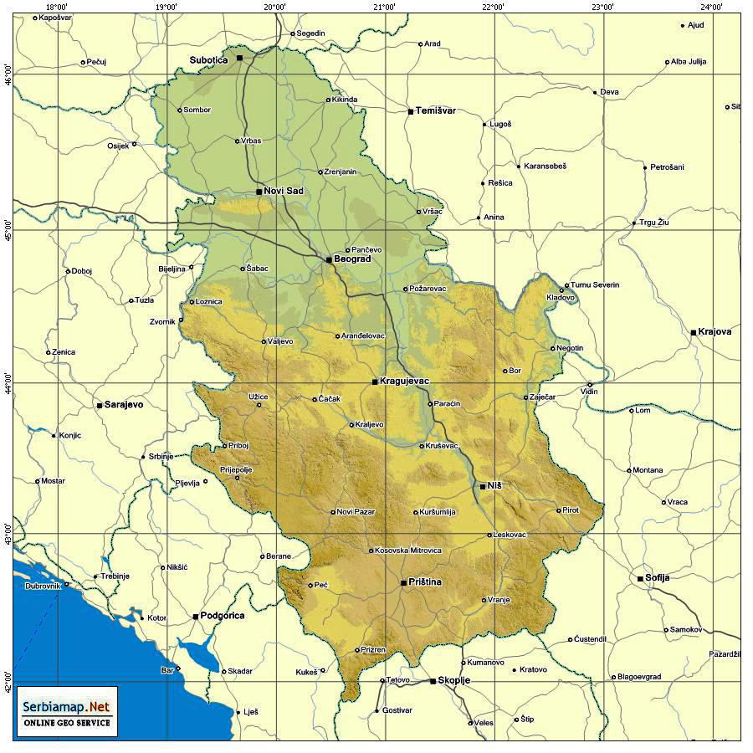
GEOGRAPHY OF SERBIA
Serbia is located in the southern part of the Pannonian Plain and in the central part of Balkan Peninsula and covers a total area of 88.361 km²
The topography of Serbia is diverse with rich, fertile plain is in the northern part while central and southern part consist mostly from hills, low, medium-high and high mountains interspersed with numerous rivers and creeks.
Strengthening of master curricula in water resources management
for the Western Balkans HEIs and stakeholders
www.swarm.ni.ac.rs

Slide 3
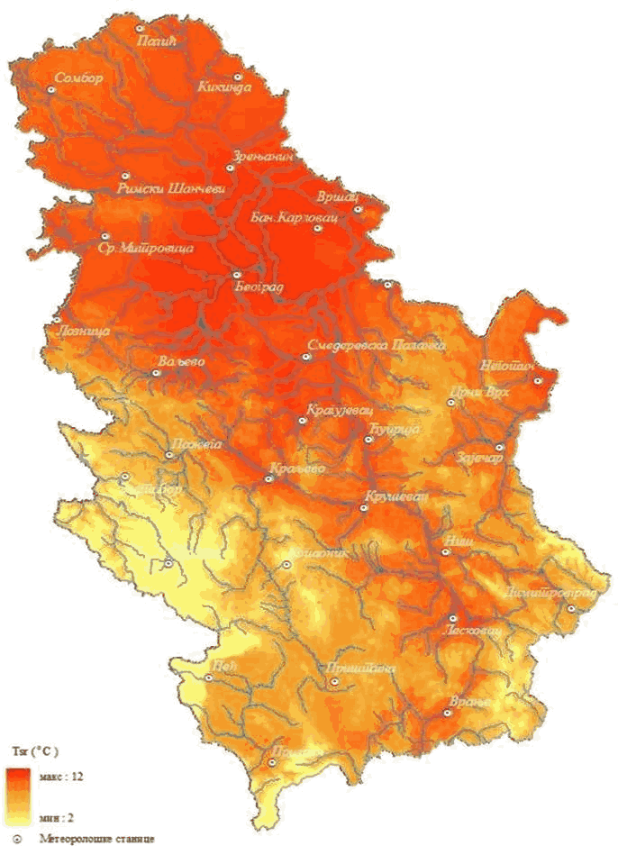
GEOGRAPHY OF SERBIA
Serbia is located in the southern part of the Pannonian Plain and in the central part of Balkan Peninsula and covers a total area of 88.361 km²
The topography of Serbia is diverse with rich, fertile plain is in the northern part while central and southern part consist mostly from hills, low, medium-high and high mountains interspersed with numerous rivers and creeks.
Climate is moderately continental with a gradual change between the seasons. Coldest month is January and the warmest is July.
The mean annual air temperature is between 10.9°C and 3°C which depends on altitude.
Strengthening of master curricula in water resources management
for the Western Balkans HEIs and stakeholders
www.swarm.ni.ac.rs

Slide 4
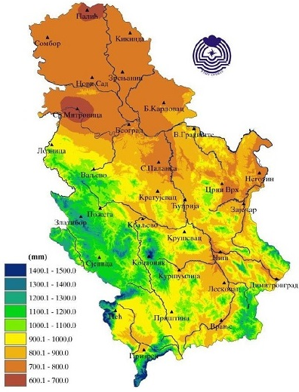
GEOGRAPHY OF SERBIA
Serbia is located in the southern part of the Pannonian Plain and in the central part of Balkan Peninsula and covers a total area of 88.361 km²
The topography of Serbia is diverse with rich, fertile plain is in the northern part while central and southern part consist mostly from hills, low, medium-high and high mountains interspersed with numerous rivers and creeks.
Climate is moderately continental with a gradual change between the seasons. Coldest month is January and the warmest is July.
The mean annual air temperature is between 10.9°C and 3°C which depends on altitude.
Precipitation regime is continental with more rainfall in warmer seasons (February and October are the least rainy months, while June is the rainiest month.
The annual precipitation is between 540 mm and 1500 mm while the average annual precipitation is 896 mm.
The continental precipitation patterns are in the majority of the country
Strengthening of master curricula in water resources management
for the Western Balkans HEIs and stakeholders
www.swarm.ni.ac.rs

Slide 5
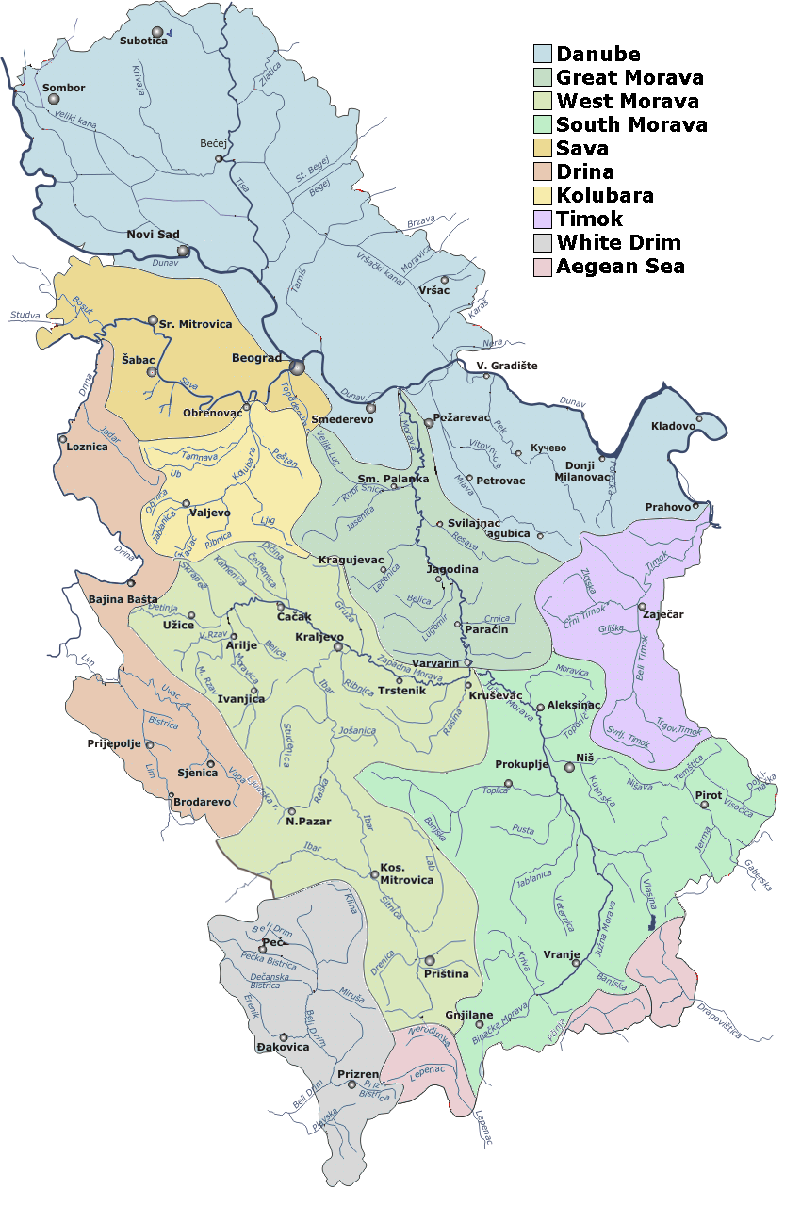
WATER RESOURCES IN SERBIA
Water resources in Serbia can be divided into:
  surface,
  underground and
  thermal water.
Surface waster resources are significantly present in Serbia while 92 % of surface waters are transit waters with main rivers such as: Danube, Sava, Tisa and Drina.
498 surface water bodies in total, from which 99 % are watercourses and 1 % are lakes.
Strengthening of master curricula in water resources management
for the Western Balkans HEIs and stakeholders
www.swarm.ni.ac.rs
Notes:
The main reasons for this situation are lack of adequate
management, various agricultural activities and drainage of waste water directly into lake without any
previous treatment.
Situation with artificial lakes is same as with natural lakes, i.e. water in lakes is
treated as a raw material, and not as an environment. All these caused degradation and inadequate
exploitation of some artificial lakes

Slide 6
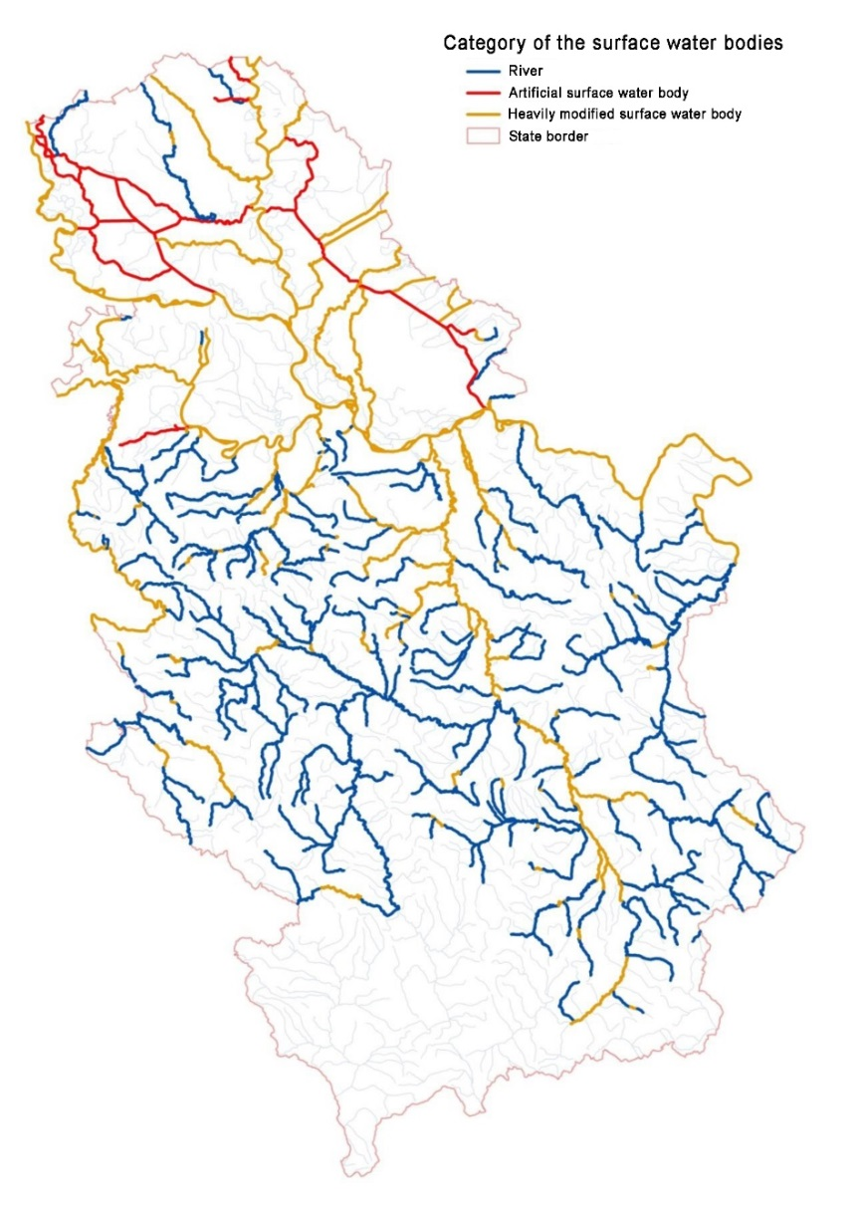
WATER RESOURCES IN SERBIA
Water resources in Serbia can be divided into:
  surface,
  underground and
  thermal water.
Surface waster resources are significantly present in Serbia while 92 % of surface waters are transit waters with main rivers such as: Danube, Sava, Tisa and Drina.
498 surface water bodies in total, from which 99 % are watercourses and 1 % are lakes.
All water bodies are grouped into three categories:
  river,
  artificial surface water body and
  heavily modified surface water body
Half of total groundwater resources are in alluvial sand-gravel sediments.
The best quality of groundwater is from karst springs however they are poorly represented in Serbia
Strengthening of master curricula in water resources management
for the Western Balkans HEIs and stakeholders
www.swarm.ni.ac.rs

Slide 7
WATER RESOURCES IN SERBIA
Serbian water resources also includes:
  significant number of artificial lakes which are mostly built for hydropower generation of electricity
  numerous underground natural and mineral water sources with high quality of water, which are to some extent used for water supply.
  significant thermal water potential, which is only partially utilized.
Strengthening of master curricula in water resources management
for the Western Balkans HEIs and stakeholders
www.swarm.ni.ac.rs

Slide 8
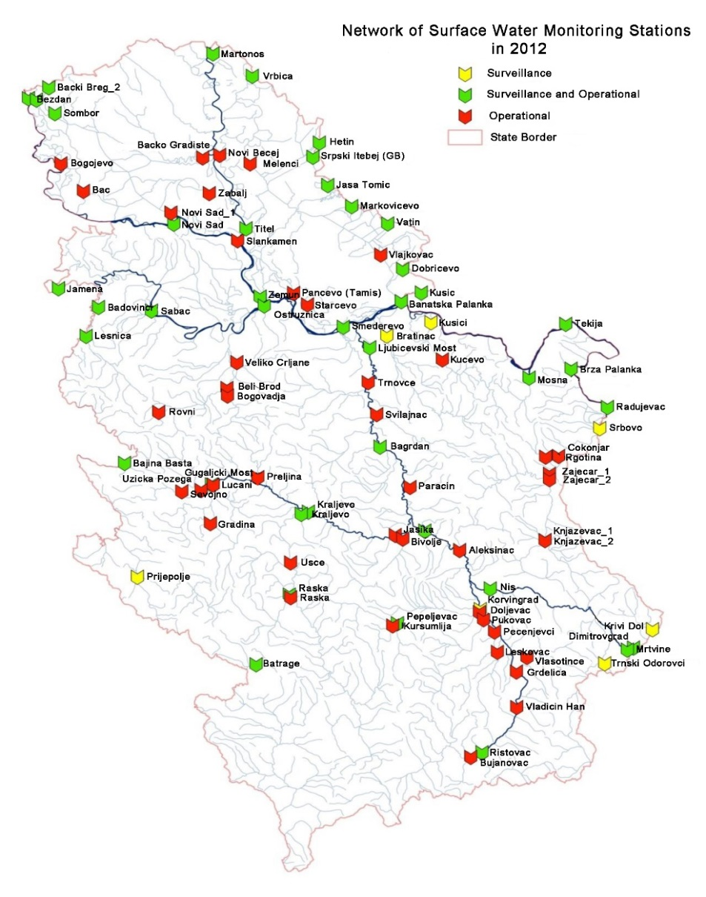
WATER RESOURCES IN SERBIA
Monitoring of surface waters in Serbia is being carried out since 2012, and it is harmonized with Water Framework Directive.
Three types of monitoring has been implemented :
  1) surveillance,
  2) operational and
  3) investigative monitoring.
Results of river monitoring shows that the worst water body status had been found in:
  Danube (100% of water bodies had unsatisfied status),
  Sava (97% of water bodies had unsatisfied status) and
  Morava (98% of water bodies had unsatisfied status)
Strengthening of master curricula in water resources management
for the Western Balkans HEIs and stakeholders
www.swarm.ni.ac.rs

Slide 9
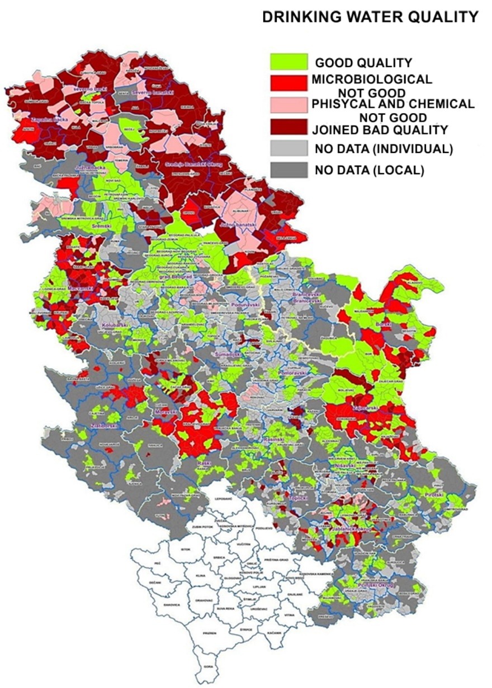
WATER RESOURCES IN SERBIA
According to the United Nations, Serbia is classified as little or no water scarcity territory
The main water lack is in the densely populated lowlands.
Quality of drinking water in Serbia is generally unsatisfactory while quality of groundwater is especially bad in Vojvodina.
Water resources with high quality are distributed around the borders of Serbia.
Strengthening of master curricula in water resources management
for the Western Balkans HEIs and stakeholders
www.swarm.ni.ac.rs

Slide 10
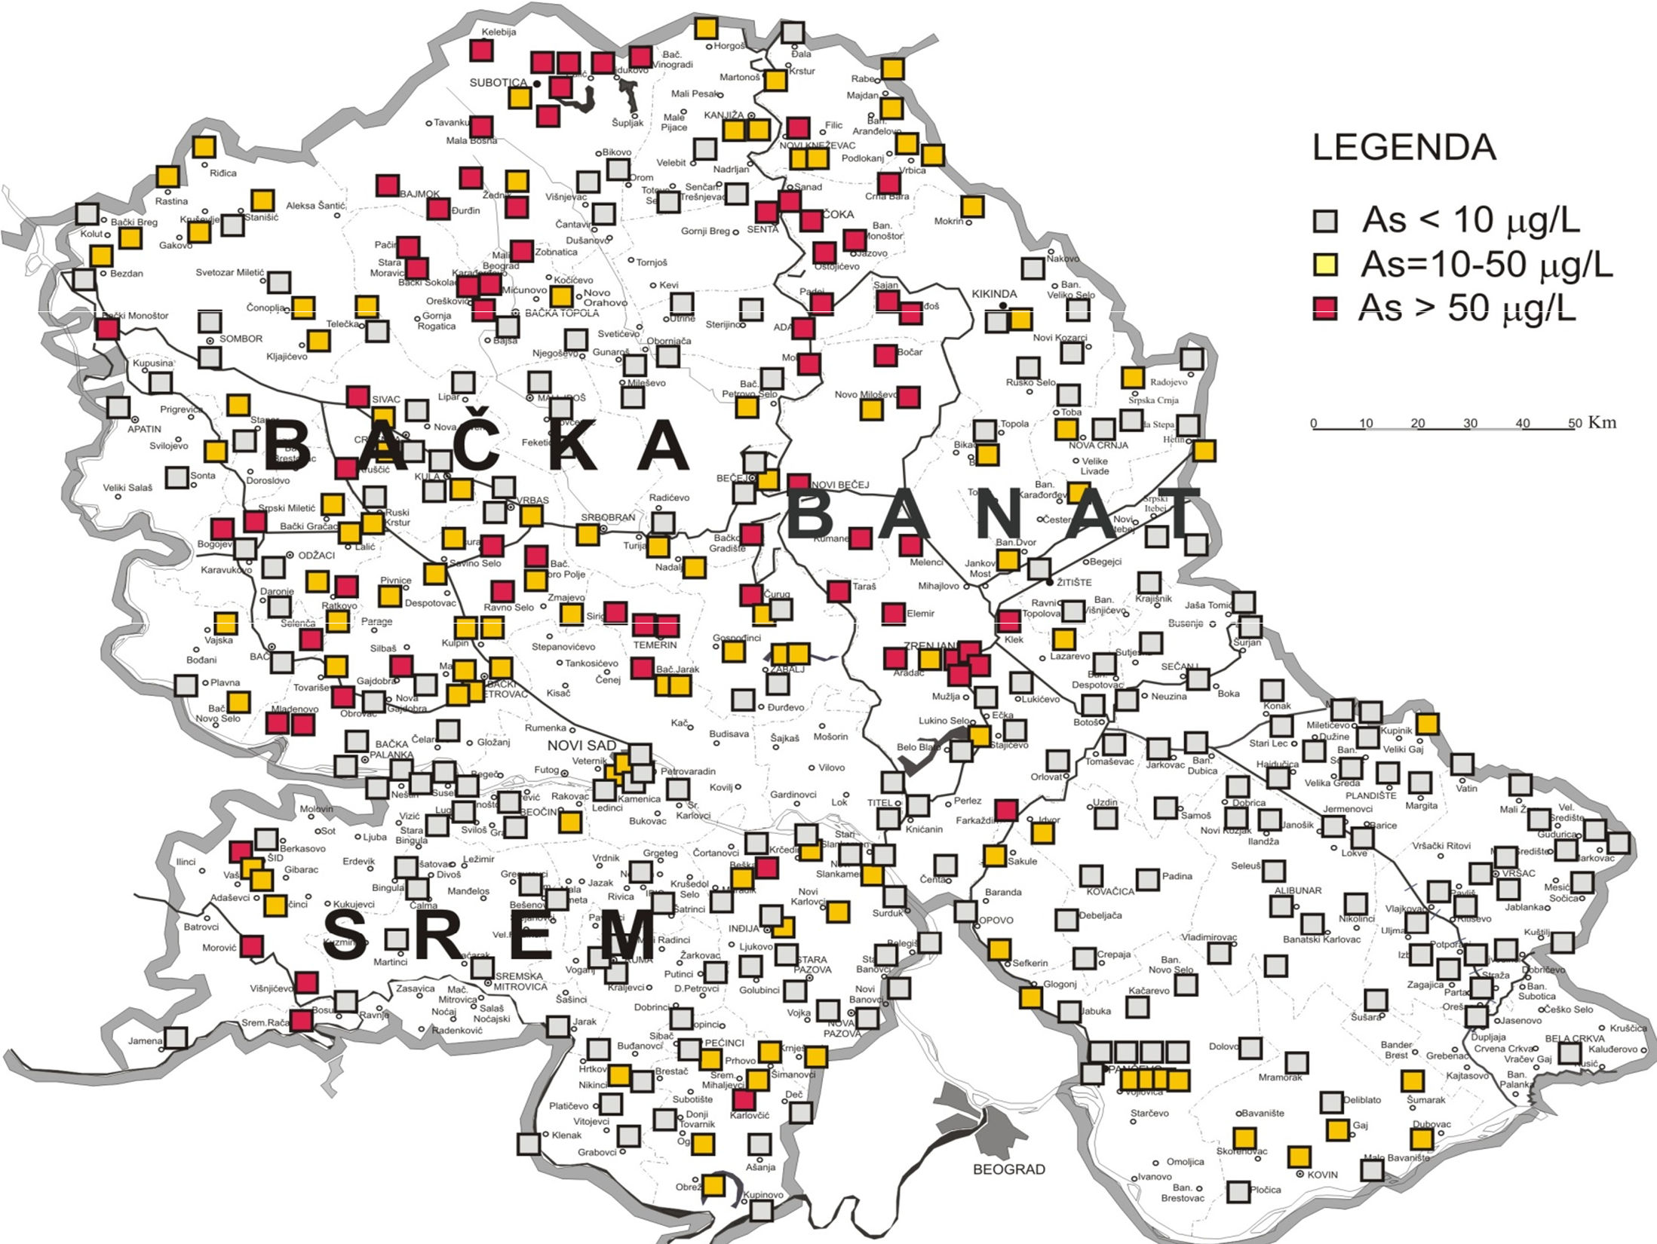
WATER RESOURCES IN SERBIA
Surface waters share in water supply is 31 %, while 69 % of water supply covers the groundwater.
Abstracted drinking water in Republic of Serbia (m³)
In Autonomous Province of Vojvodina 100 % of drinking water originate from groundwater sources
LEGEND
ARSENIC IN DRINKING WATER (AP VOJVODINA)
Strengthening of master curricula in water resources management
for the Western Balkans HEIs and stakeholders
www.swarm.ni.ac.rs

Slide 11
WATER RESOURCES IN SERBIA
Chemical status of surface waters shows, that 59 % of surface waters has good status and 41 % has poor status.
The main causes for this status were high level of dissolved nickel, dissolved lead, fluoranthene and endosulfan
Bacteriologically contaminated water is the main problem in Central Serbia, where more than 40 % is unsatisfactory, while in north region of Vojvodina the main problems are turbidity, presence of iron, nitrates and arsenic
Current situation with natural lakes in Serbia, shows water degradation due to the agricultural activities and drainage of wastewater directly into lake without any previous treatment
Strengthening of master curricula in water resources management
for the Western Balkans HEIs and stakeholders
www.swarm.ni.ac.rs

Slide 12
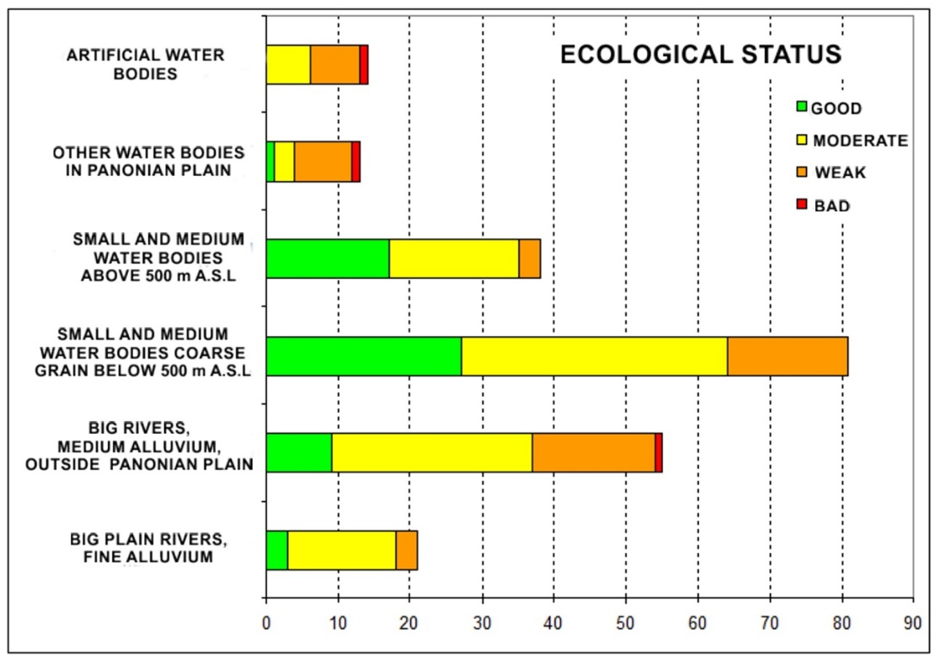
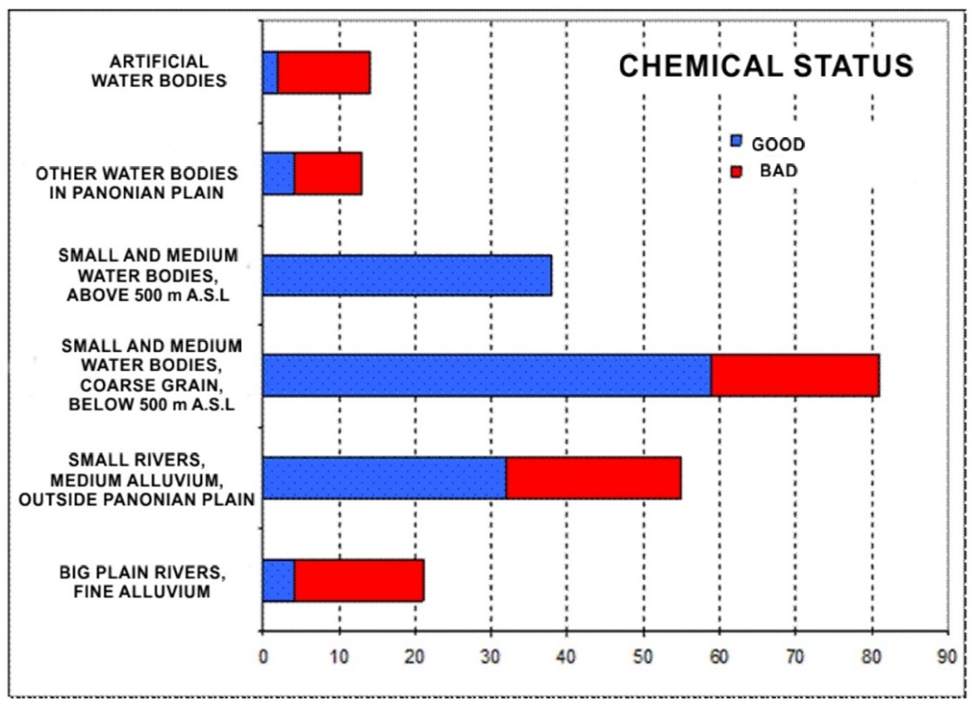
WATER RESOURCES IN SERBIA
Strengthening of master curricula in water resources management
for the Western Balkans HEIs and stakeholders
www.swarm.ni.ac.rs

Slide 13
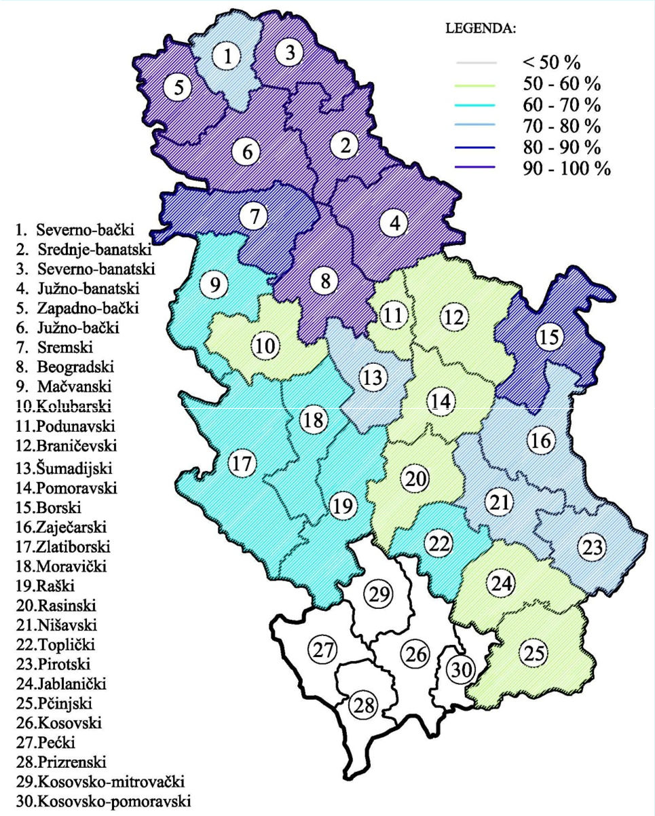
WATER RESOURCES IN SERBIA
81 % of inhabitants of Serbia are connected to the public water supply (mostly in Belgrade and Vojvodina with more than 90 %)
The main problems for water quality impairment (in supply systems) are:
  inadequate technological development
  low economic development and
  underdeveloped awareness on water protection.
Water accumulations are exposed to erosion, to sediments accumulation and to eutrophication.
Strengthening of master curricula in water resources management
for the Western Balkans HEIs and stakeholders
www.swarm.ni.ac.rs

Slide 14

WATER MANAGEMENT IN SERBIA
Water management in Serbia is under the jurisdiction of the national government (Ministry of Environmental Protection, Ministry of Agriculture, Forestry and Water Management, National Water Directorate and government-held water management companies)
Government of Serbia in 2018 allocated approximately 0.6 % of GDP for water resources while the estimations for the minimal and optimal development are about 1% and 2% of GDP respectively.
Territory of Serbia is exposed to various forms of natural disasters of which the most frequent are floods, landslides and droughts. It is predicted that the economic costs of unfavorable natural events will increase in the future, taking into account increased concentration of the population in urban areas.
Strengthening of master curricula in water resources management
for the Western Balkans HEIs and stakeholders
www.swarm.ni.ac.rs

Slide 15
WATER MANAGEMENT IN SERBIA
Wastewaters are one of the main polluters of water in Serbia.
The sewage network covers about 55% of the population, while settlements larger than 2000 inhabitants are covered with approximately 72% of the sewage connection
Out of 44 wastewater treatment plants, only 6 operate efficiently and they can treat only 8 % of total wastewater
320 wastewater treatment plants are needed, in order to align with EU standards.
Industrial wastewaters pose a significant threat to environment, because 50 % of industrial facilitates do not treat wastewater, and over the past few years the volume of wastewater from industry has risen substantially (especially in mining industry)
Strengthening of master curricula in water resources management
for the Western Balkans HEIs and stakeholders
www.swarm.ni.ac.rs

Slide 16
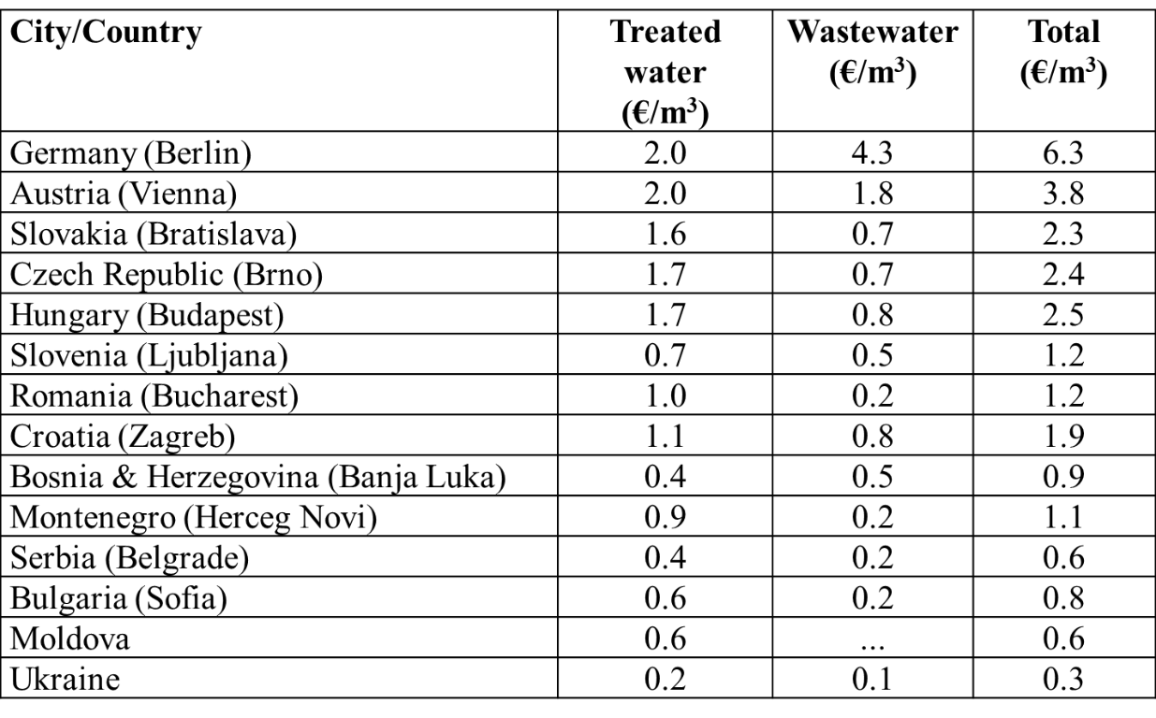
WATER MANAGEMENT ISSUES IN SERBIA
Economic price for drinking water (which includes drinking water supply, water discharge and treatment) as main method of financing of Local Public Water Utilities in Serbia is very low (0.6 – 0.72 €/m³), while the real economic price for drinking water in order to secure proper functioning and maintenance of the water distribution system should be 1.5 €/m³.
Strengthening of master curricula in water resources management
for the Western Balkans HEIs and stakeholders
www.swarm.ni.ac.rs

Slide 17
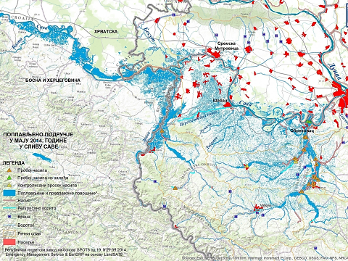
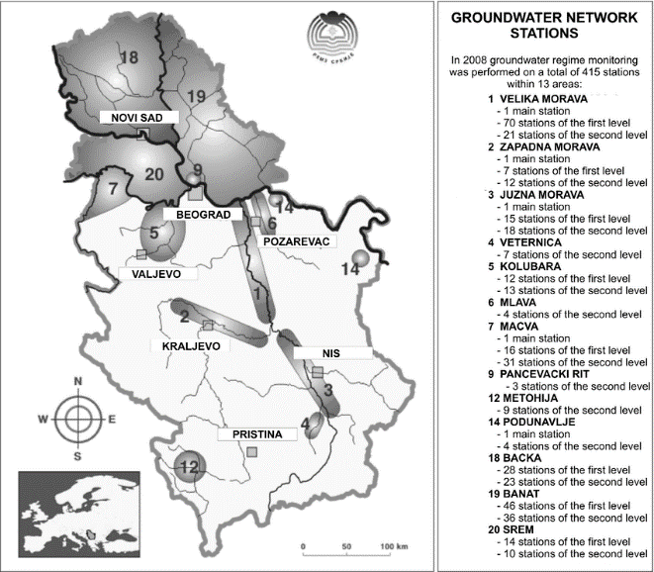
WATER MANAGEMENT ISSUES IN SERBIA
Insufficient investment in water sector in last 20 years
Water losses in water supply networks are large, because the networks are poorly maintained.
Water protection is the weakest part of the water management system. i.e. poor application of legislation in wastewater treatment
Flood protection is the main problem in the area of protection from water. Maintenance of the existing systems for flood protection is minimal, which causes the reduction of systems functionality.
Irrigation systems cover the small parts of arable land and
Drainage systems have poor maintenance, which causes the reduction of system efficiency.
Strengthening of master curricula in water resources management
for the Western Balkans HEIs and stakeholders
www.swarm.ni.ac.rs

Slide 18
WATER MANAGEMENT ISSUES IN SERBIA
Coordination and cooperation in the planning and implementation of programs is on unsatisfactory level.
Decentralized management, which is applied in developed countries, is at the beginning in Serbia. Insufficient capacity for implementation of legislative requirements and goals especially in smaller municipalities
It is necessary to adopt the new, functional and sustainable concept of water management based on groundwater, and artificial reservoirs, if there is not enough groundwater quality or quantity.
There is not enough a full defined projects for whose implementation international funds could be sought
Groundwater is not adequately covered in water monitoring
Strengthening of master curricula in water resources management
for the Western Balkans HEIs and stakeholders
www.swarm.ni.ac.rs
Notes:
Municipal self-government often not capable to secure any kind of strategic development
All of that indicate than Serbia will need much more time than it really necessary to develop waste management system

Slide 19
Thank you!
Strengthening of master curricula in water resources management
for the Western Balkans HEIs and stakeholders
www.swarm.ni.ac.rs

